Slide 1
Agentic AI for Business Strategy Learning
Paloma Pérez de Madrid – MSc Artificial Intelligence

Slide 2
Table of contents
01
02
03
04
05
06
Problem & Motivation
Proposed Solution
Why Agentic AI?
System Overview (High Level)
Learning Evaluation & Contribution
Feasibility & Scope

Slide 3

Current challenge in strategy education
01
Problem & Motivation
01 02 03 04 05 06
Business strategy is mostly taught through static case studies
Students analyse past decisions but rarely experience strategic trade-offs
Limited opportunities to practice:
Sequential decision-making under uncertainty
Multi-actor negotiation (clients, competitors, financiers)
Financial consequences of strategic choices
Motivation
Effective strategy learning requires iteration, feedback, and consequences
Existing teaching tools lack interactivity, adaptability, and reasoning traceability
students learn what to think, but not how to decide over time.

Slide 4
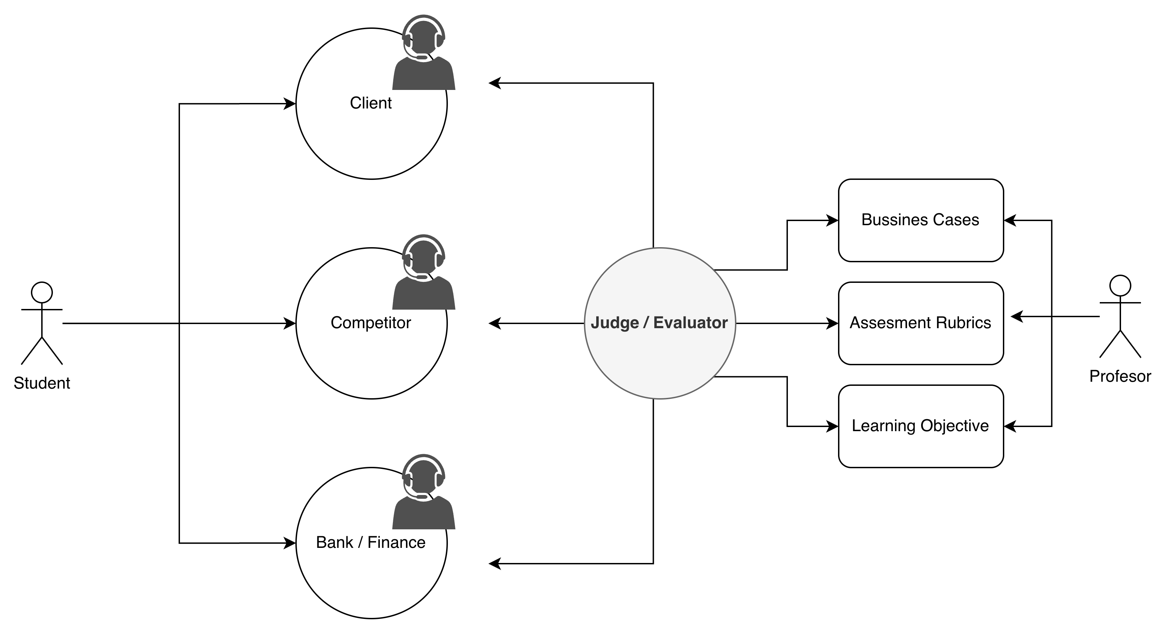
An agentic AI–based strategy simulation
02
Proposed Solution
01 02 03 04 05 06
A simulated business environment where students make strategic decisions
AI agents act as clients, competitors, financial institutions, and market forces
Agents reason, act, and interact in response to student decisions
The system provides structured feedback and reasoning traceability
Move from case analysis to strategy practice through interaction and consequences

Slide 5
An agentic AI–based strategy simulation
03
Why Agentic AI?
01 02 03 04 05 06
Limitations of single-assistant systems
Reactive: respond to prompts but do not manage evolving situations
No persistent roles, memory, or consequences
Limited support for negotiation and strategic interaction
Advantages of an agentic approach
Reason: agents plan and reflect on decisions
Act: agents use tools (financial models, simulations)
Interact: multiple agents negotiate and respond strategically
Agentic AI
Educational value
Mirrors real-world strategic environments
Enables adaptive scenarios and explainable evaluation
Not a conversational assistant, but an interactive, evaluative learning system

Slide 6
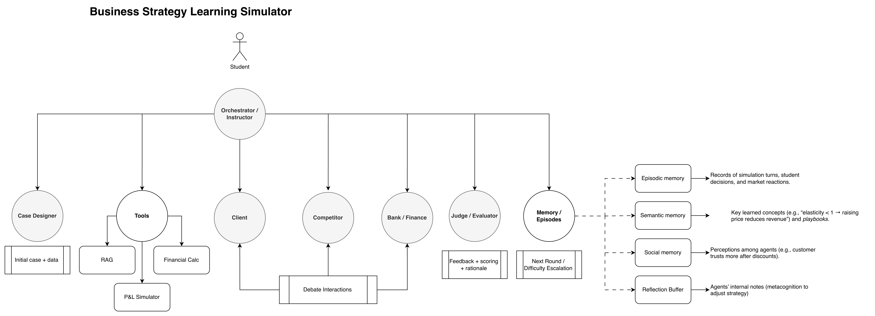
Agent-based learning environment
04
System Overview (High Level)
01 02 03 04 05 06
Orchestrator agent Defines learning objectives, adapts difficulty, and structures feedback
Scenario & Case Designer agent Generates business contexts, constraints, and market conditions
Role-playing agents Clients, competitors, and financial institutions with distinct objectives
Judge / Evaluation agent Assesses decisions using a pedagogical rubric and explains outcomes
Student Makes strategic decisions and observes consequences over time

Slide 7
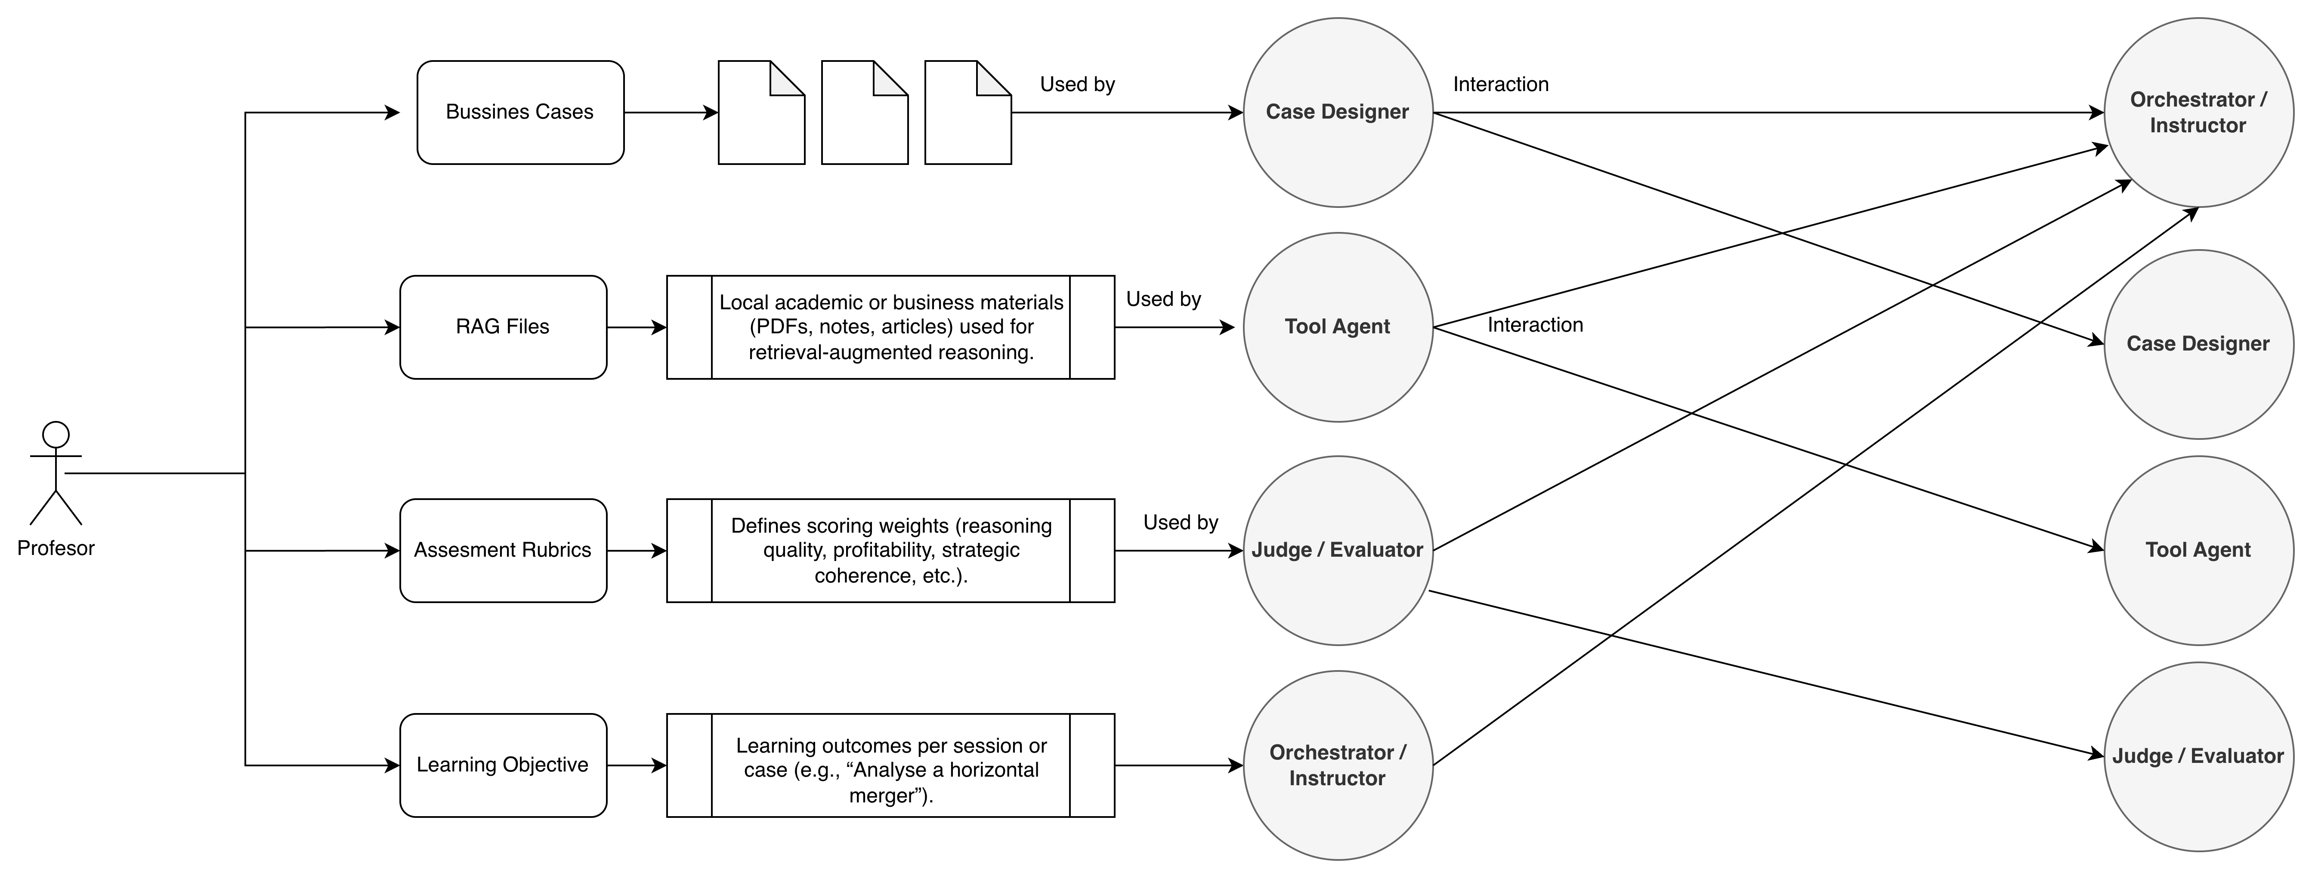
Lecturer can tailor the system
04
System Overview (High Level)
01 02 03 04 05 06
Instructors can adapt the pedagogical content of the simulation through four clearly separated configuration points: business cases, RAG knowledge files, assessment rubrics, and learning objectives. These inputs are read by the CaseDesigner, Orchestrator, ToolAgent, and Judge agents respectively. The core LangGraph structure, memory system, and reasoning processes remain fixed to guarantee consistency and reproducibility across sessions.

Slide 8
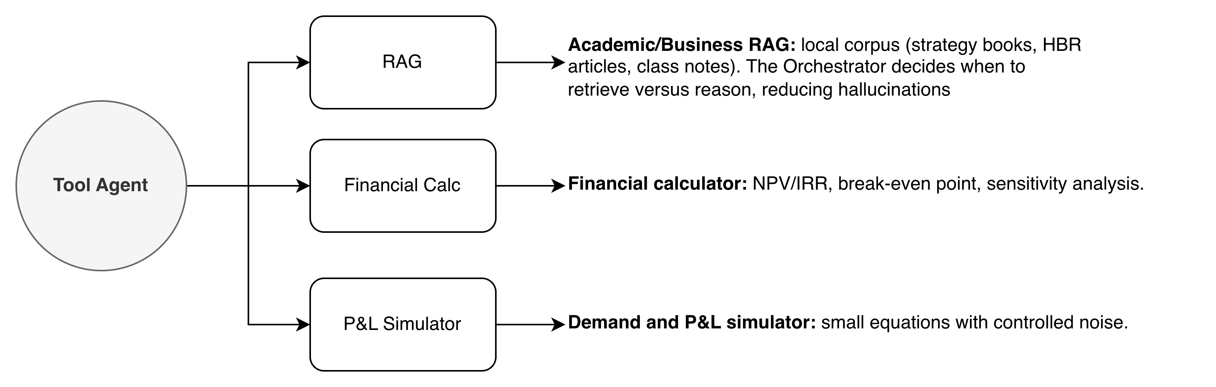
Agents have access to different tools
04
System Overview (High Level)
01 02 03 04 05 06
Tool Agent acts as the action layer of the system, abstracting access to external tools. It decides when to retrieve domain knowledge through RAG, when to perform quantitative reasoning using a financial calculator, and when to evaluate strategic consequences via a P&L simulator. This separation allows other agents to focus on decision-making and interaction, while the Tool Agent ensures that actions are grounded in data, calculations, and controlled simulations.

Slide 9
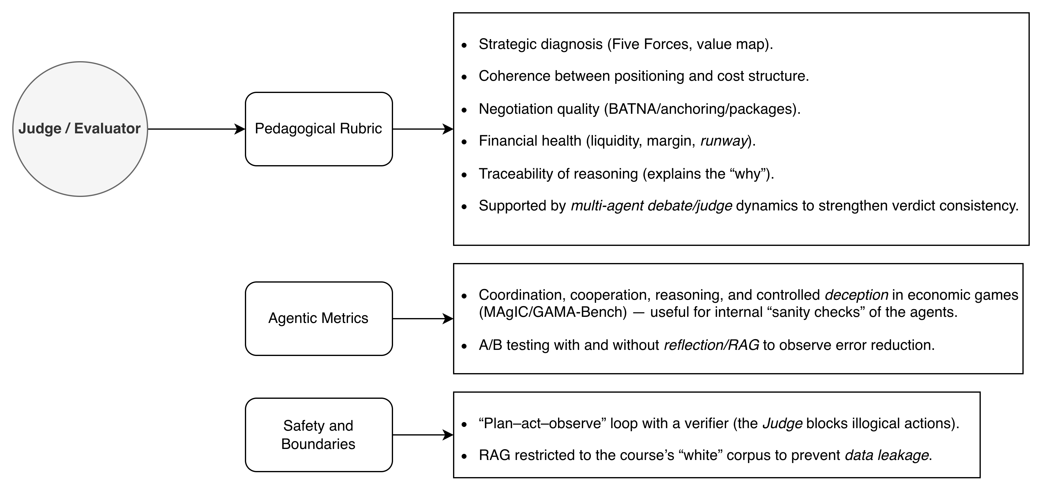
Learning and System Evaluation
04
System Overview (High Level)
01 02 03 04 05 06
To ensure both pedagogical rigour and system reliability, evaluation operates on two intertwined levels: student learning outcomes and the internal behaviour of the agentic system itself. The approach combines human-like assessment (through rubrics and debates) with automated benchmarks for reasoning, coordination, and control.

Slide 10

Learning and System Evaluation
05
Learning Evaluation & Contribution
01 02 03 04 05 06
Learning evaluation
Decisions are assessed using a structured pedagogical rubric covering:
Strategic diagnosis and coherence
Competitive positioning and pricing logic
Negotiation quality
Financial sustainability
Transparency of reasoning
Feedback is explainable and iterative, supporting learning over multiple rounds.
Academic contribution
Demonstrates how agentic AI can support learning by doing in strategy education
Integrates multi-agent interaction, tool-based action, and explainable evaluation
Provides a reproducible framework for teaching and assessing strategic decision-making
Possible stack:
LangGraph
LangChain
NumPy / Pandas
Node.js / Flask

Slide 11
Learning and System Evaluation
06
Feasibility & Scope
01 02 03 04 05 06
Defined scope
Focus on a single business domain (e.g. Retail)
Limited number of agents:
Instructor / Orchestrator
Client
Competitor
Judge / Evaluator
One complete end-to-end simulation loop
Technical feasibility
Built on existing agentic AI frameworks (LangGraph, LangChain)
Lightweight financial models and stochastic simulations
Explicit state and memory design to control complexity
Deliverables
Working prototype with logged simulations
Evaluation framework and reproducible experiments
Documented architecture and design decisions

Slide 12
Thanks!
Do you have any questions?
> ppdm1@st-andrews.ac.uk
Thank you for your time and consideration.

